Slide 1
Barcodes
PrintNet T

Slide 2
Context Schema
Workflow
Data Input
&
Manipulation
Document
Design
(Layout)
Impositioning
Approval (Proof)
Spool Production
Notes:
Barcodes are inserted and formatted in PrintNet T Layout.

Slide 3

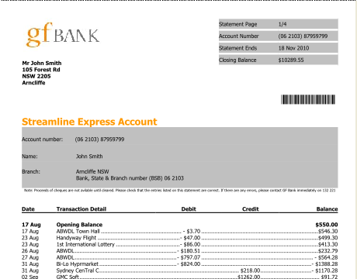
Barcodes – Introduction
PrintNet T supports barcode printing

Slide 4

Barcodes – Purpose
Barcodes:
  Store information
  Are read by a laser scanner
  Can immediately identify, separate, and group documents
  SAVE TIME AND MONEY!!
Notes:
Many documents and other materials use barcodes as a kind of identification code. Barcodes can group and identify specific groups with a common factor, or they can be specific to each individual customer. Depending on your needs, you will have to specify a particular variable by which barcodes will be grouped and/or separated.
Example I (next slide): A company produces a mailing package for each of their customers which includes a document, an invoice, and an envelope. Each of these materials is printed simultaneously for each customer on separate printers; afterward, they need to be sorted so that each customer gets their own personalized document, invoice, and mailing envelope. Barcodes can be used to sort each of these materials by customer. Imagine the time it would take to do this for 10,000 customers, without using barcodes!

Slide 5









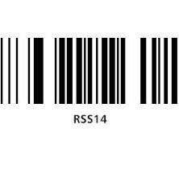
Barcodes – Example I
A company prints a document, an invoice, and an envelope for each of their customers; barcodes are used to scan each of these and group them together for mailing.
Barcodes are read on all materials
Three printers printing different materials for different customers, with different barcodes
Materials are sorted and grouped by barcode; ready for mailing
= Customer 1 / Barcode 1
= Customer 2 / Barcode 2
= Customer 3 / Barcode 3
Notes:
Example I: A company produces a mailing package for each of their customers which includes a document, an invoice, and an envelope. Each of these materials is printed simultaneously for each customer on separate printers; afterward, they need to be sorted so that each customer gets their own personalized document, invoice, and mailing envelope. Barcodes can be used to sort each of these materials by customer (“CustID” variable). Imagine the time it would take to do this for 10,000 customers, without using barcodes!

Slide 6


Barcodes – Example II
A Canadian company ships many documents to different locations across the country. The company gets a discount if they sort their own bulk mail by postal code. Barcodes can sort envelopes by location.
Barcodes are read
Company prints documents bound for different locations
Sorted by postal code
Shipped
= Ottawa, Ontario
= Montreal, Quebec
= Toronto, Ontario
Notes:
Example II: Imagine a company based out of Winnipeg, Manitoba. They have to print thousands of documents and mail them to different locations across Canada (e.g., Ottawa, Montreal, and Toronto). However, it isn’t as simple as just putting all the documents in the mailbox. Canada Post offers the company a discount on their bulk mailings if they sort the mail by postal code themselves (saving Canada Post the trouble).
The company uses a “PostalCode” variable and sorts the barcodes by this variable. Then, the barcodes are printed on the envelopes, enabling quick sorting of the mail based on where it is going, and ultimately saving the company a lot of money in shipping charges (especially if they send out a mailing monthly or bi-weekly, etc.).

Slide 7
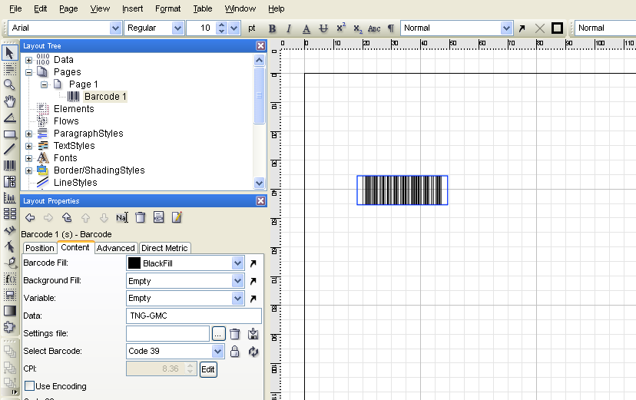

Adding Barcodes
Notes:
The barcode tool is in the tool bar. Select it, and drag and drop in the Layout area.

Slide 8
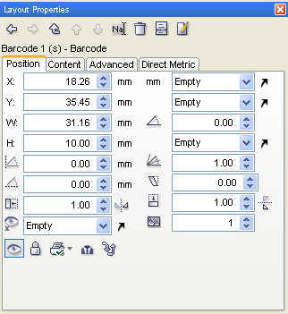
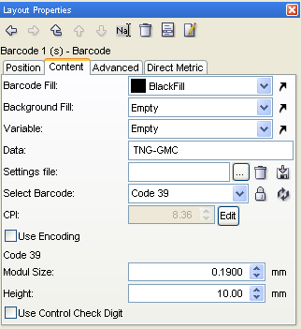
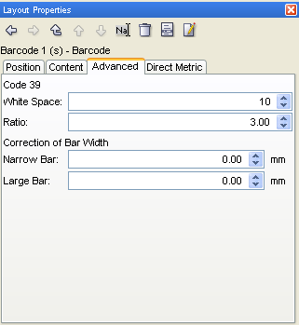
Barcodes – Layout Properties
Three Important Tabs:
Position
Content
Advanced

Slide 9

Barcodes – Content Tab
Change the colors of a barcode and barcode background
Change the variable of a barcode
Save or load barcode settings
Select type of barcode
Enhanced barcode settings
Notes:
NOTE: Be very careful when changing the settings of a barcode. Applying some settings may render the barcode unscannable. Always ensure that your barcodes will scan before printing large quantities.
Colors of your barcode can be changed from the traditional “black and white” to a combination of your choosing.
Barcodes usually need a variable. For example, if your barcode variable is “CustZIP”, then all barcodes will differ from record to record; however, customers who have the same zip code will also have the same barcode.
Like Data Transformer settings, commonly-used barcode settings can be saved to a separate file and loaded again in more than one PrintNet T job.
Module size and height are more advanced settings of barcodes – you will not have to worry about this for now.

Slide 10
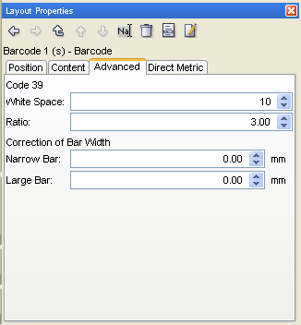
Barcodes – Advanced Tab
  Specific enhancements for each barcode type
  Advanced tab changes for each different barcode type
Notes:
The Advanced tab provides the possibility for very specific alterations to a barcode type.
The content of the Advanced tab changes for each barcode type selected, depending on individual barcode type settings (i.e., the content of the Advanced tab will be different if you have Code 39 type barcode than if you have a Japan Post type barcode). For some barcode types, such as UPC A, the Advanced tab doesn’t even appear – you can’t change the settings.

Slide 11
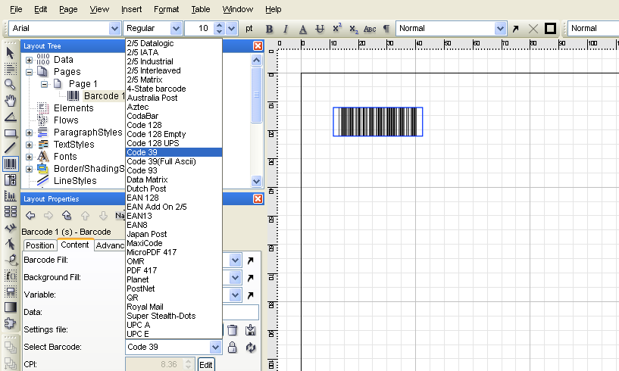
Barcode Types – Example
Select the type of barcode.

Slide 12





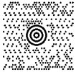
Barcode Types – Example
Different barcode type options.
Code 39
4-State barcode
2/5 Industrial
Japan Post
PostNet
UPC A
Aztec
Royal Mail
Super Stealth-Dots
Maxi code
Notes:
Code 39: widely used in non-retail environments; used by the Health Industry Bar Code Council, and the U.S. Department of Defense.
4-State barcode: used by the U.S. Postal Service, Australia Post, Royal Mail (in the U.K.), and Canada Post; holds more information but doesn’t take up much more space.
2/5 Industrial: used in airline ticketing and photofinishing.
Aztec: used by German and Swiss trains for online ticket sales and verification.
Japan Post: similar to 4-state; used by Japan Post.
PostNet: used by U.S. Postal Service to help direct mail.
UPC A: maybe the most common and well-known barcode; “Universal Product Code”; used on all consumer and retail items.
Royal Mail: used by Royal Mail in the U.K.
Super Stealth-Dots:
Maxi code: created and used by the United Parcel Service (UPS); good for tracking and managing shipment of packages.
For more information on barcodes see http://www.barcodeisland.com/code39.phtml or http://en.wikipedia.org/wiki/Barcode

Slide 13
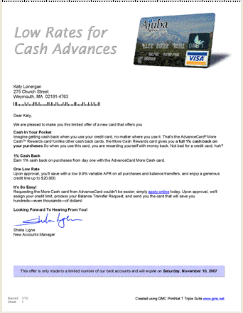
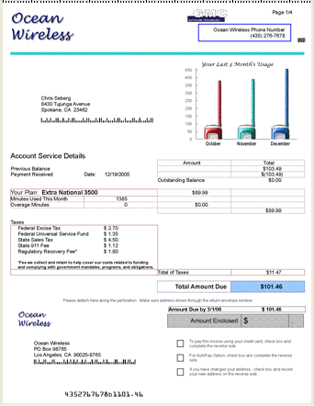
Barcodes – Layout
Barcodes can be placed anywhere on the Layout page.
Notes:
Picture 1: A very simple letter, advertising the features of a credit card. The single PostNet barcode stores the customer’s address information. Possibly used for sorting customers by location (Country, State, ZIP, etc.)
Picture 2: Here there are three barcodes in a more complex context. Like Picture 1, the PostNet barcode stores the customer’s address information. A second PostNet barcode at the bottom of the page will be fixed, because it is on the detachable return card to be mailed back to the company (“Ocean Wireless”) – the address will always be the same. A third barcode, MicroPDF 417, appears in the top right-hand corner, and likely stores customer phone numbers.

Slide 14
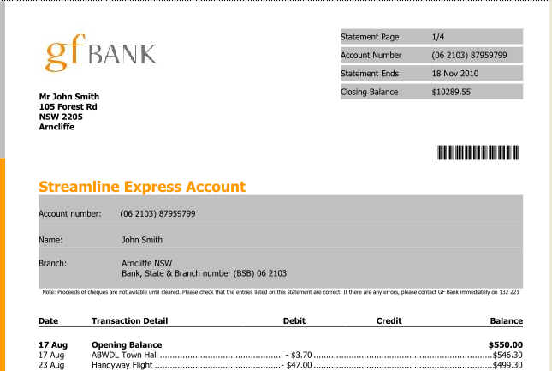
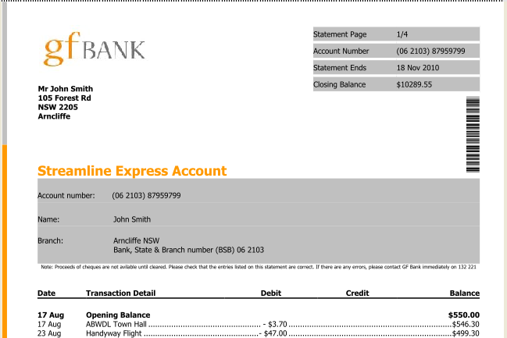
Barcodes – Layout
  Rotation:
  All Layout objects, including barcodes, can be rotated.
Notes:
Depending on how a user wants their Layout to look, objects may need to be rotated. All objects in PrintNet T can be rotated: flow areas, shapes, images, barcodes, etc.
In some cases, rotating a barcode might be an absolute necessity (e.g., if all barcodes will be scanned automatically by a stationary machine, then it will be necessary to have the barcode in a precise place on the document, and it must be lined up with the lasers of the barcode scanner).

Slide 15




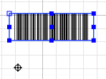
Rotating Barcodes and Other Objects
Rotate Tool:
Rotation point appears on object
Possible to move rotation point (click and drag)
Notes:
Click on the rotation tool and the selected object will become an object for rotation. A target-like rotation point will appear on the object; it is possible to move this rotation point anywhere on or off the object you’re going to rotate. There are some fixed points on the object which help you to find a logical rotation point (e.g., a corner, dead center, etc.).

Slide 16
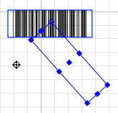
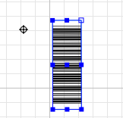
Rotating Barcodes and Other Objects
Once rotation point is set, just click object and drag it around the point.
Notes:
Rotation point acts as an anchor around which the object will be rotated.

Slide 17
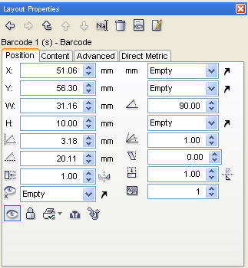
Rotating Barcodes and Other Objects
Position Tab:
For more precise rotation, input coordinates in an object’s Position tab.
Notes:
An alternative, more precise, and ultimately more desirable method of rotating an object is to input exact rotation coordinates into its Position tab in Layout Properties. This way, there is no “eyeballing” involved. There is no guesswork – simply input a number, hit <Enter>, and the object will rotate clockwise by that many degrees as the number submitted.
Remember, all objects have a Position tab, so all objects can be rotated this way too.

Slide 18
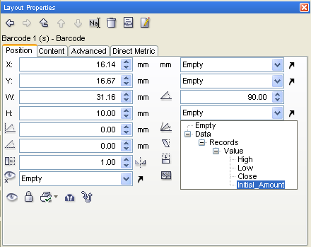
Variable Rotation
Objects can also have variable rotation.
Notes:
Variable rotation could be useful if, for instance, a user wants some documents that meet a certain criteria to be scanned by one barcode reader, and the other documents that don’t meet the certain criteria to be scanned by a different barcode reader which is set up 90° to the first reader.
For variable rotation, the variable by which rotation will be determined must be of the type Double.

Slide 19

Barcodes – Exercise
Insert a barcode to a letter and assign a variable to it.
  Open BarcodesExercise.wfd
  In Layout, insert a barcode and make it PostNet type
  Assign the CustZIP variable to the barcode
  Rotate the barcode 90° and put it along the top left side of the page.
  Proof your job <F6>
Notes:
See BarcodesExercise_done.wfd for exercise resolution.

Slide 20

Barcodes – Exercise
Exercise Resolution.
Notes:
Notice also how the barcode changes from record to record. This is because all customers in this data file have different ZIP codes; therefore, the CustZIP variable will produce a different barcode for their unique ZIP codes.
See BarcodesExercise_done.wfd for exercise resolution.

Slide 21

Barcodes – Summary
In this presentation we have learned:
  How barcodes can save time and money on mass mailings
  How to apply a variable with which to sort barcodes
  How to rotate barcodes and all other Layout objects

Slide 22

Thank You.
Do You Have Any Questions?

